Slide 1





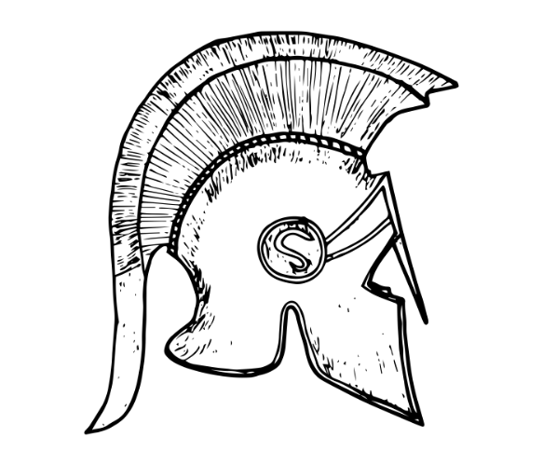


Our Learning Journey of History
Crime and Punishment
Summer Term
Battle of Sedgemoor
Spring
Term
Stone Age to Iron Age (Sep 2022 only)
Autumn
Term
Ancient Greece
Y6
Summer Term
Benin
Spring
Term
Romans
Anglo Saxons and Vikings (From Sep 2023)
Autumn
Term
Summer Term
Y5
Spring
Term
Stone Age to Iron Age (Sep 2022 only)
Autumn
Term
Y4
Summer Term
Shang Dynasty
Spring
Term
Stone Age to Iron Age
Autumn
Term
Y3
Florence Nightingale and Mary Seacole.
Flight: First Flight. Fleet air museum trip
Spring
Term
Summer Term
Fire of London
Man on the moon: Neil Armstrong
Autumn
Term
Y2
Summer Term
Y1
Autumn
Term
Spring
Term
Gunpowder Plot
Toys

